Slide 1
RIS JSF Overview
Why JSF?
JSF Components
JSF Lifecycle

Slide 2
Why JSF?
Component based – can use existing components or build your own (h:commandButton, pfghtml:tier1)
Easy to use
  Validation
  Security
Easily visualized relationship between backing bean and UI (typically xhtml)
Able to move all business logic to the Java layer (versus most business logic being in the view, ie: XSLT)

Slide 3
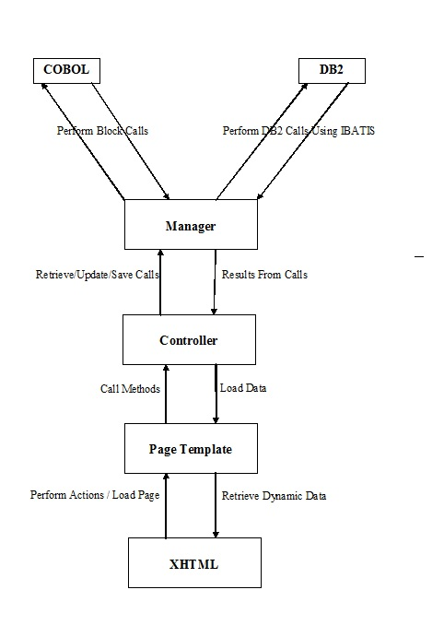
JSF Components - interaction

Slide 4
JSF Components
Template
  Minimal business logic
  Stateful - Scoped – typically session or pensionContext
  Often used for persistence of fields on XHTML
XHTML
  Renders HTML for the browser
  References backing beans for persistence - Template

Slide 5
JSF Components - interaction

Slide 6
JSF Components - cont
Controller
  Handles a majority of the work
  Stateless – no persistence
Manager
  Used to execute calls outside the application
    DB2, mainframe, etc.
  Called by Controller

Slide 7
JSF Components - interaction

Slide 8
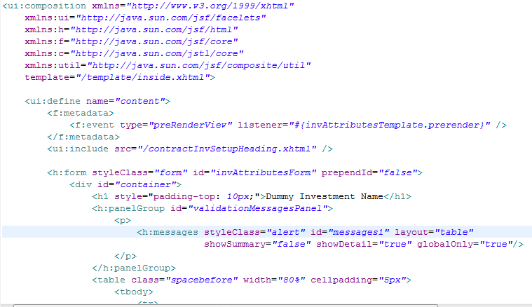
Facelets Template (.xhtml)
Web page presentation logic
Combination of HTML / JSF tags, Javascript, and CSS that will ultimately render an HTML file that gets sent back to the user’s browser

Slide 9
JSF Tags
JSF tags do 2 main things:
  Generate HTML
    JSF tag
    <h:inputText …>
    generates
    HTML tag
    <input ….>
  Tie HTML fields to
  JSF component tree
    This ultimately allows for mappings between HTML form fields and our Java code.

Slide 10
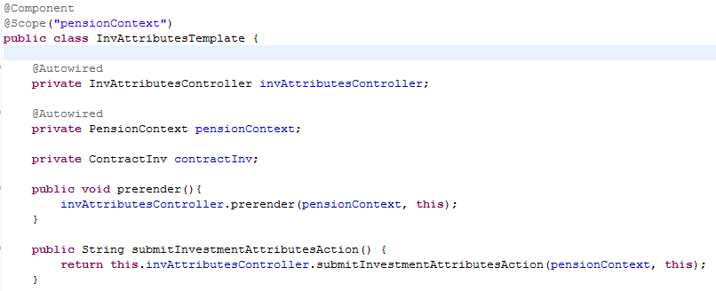
Template Backing Bean

Slide 11
What is a bean?
The standard definition of a bean, or Javabean, is an object that can be created and manipulated without programming. Generally, a bean is an object that has an empty constructor and it’s attributes (instance variables) can be manipulated with getter/setter methods.
Beans are sort of like a design pattern of how you can create a class.
Frameworks can easily work with classes that follow this convention.
Any classes that have getters/setters could be considered a bean and be used by frameworks that work with beans.

Slide 12
Managed Beans (Backing Beans)
Managed beans are instances of classes (classes that follow the bean standards) that are managed by a context / container.
A container is really just a java program that is responsible for managing those instances.
Instance of ContractInvJdbcManager.java
MyProgram.java
Instance of PlanJdbcManager.java
Sample Container

Slide 13
Bean Scopes
Beans can be declared with different scopes.
In RIS, we use 4 main scopes:
  Singleton (default spring bean scope)
  pensionContext (custom scope for web apps only)
  Request
  Session

Slide 14
Singleton Scope
The default scope of a Spring bean is a singleton, and this is how we scope all non-web app beans.
This means there will be only 1 instance of the class that is shared by everything.
This is efficient because it means multiple users share the same instance.
This can be dangerous because multiple users share the same instance.

Slide 15
pensionContext/Session
pensionContext – contract based for a given session
  New contract resets all pensionContext scoped beans
Session scope – primarily used when pensionContext is not available (non contract based applications)
  Beans live throughout the entire browser session
  Beans expire after timeout or sign out

Slide 16
Request Scope
Request scoped beans live only for the single page request.
  We want the page to render the same every time
  An example would be an online form that is submitted once

Slide 17
What should be a bean?
Something we want there to only be one instance of per application (singleton scope)
  Managers
  Infrastructure classes, such as datasources, transaction managers, block caller, etc.
  JSF Controllers
JSF backing beans – session (pensionContext) scoped
  Templates
    PensionContext scoped means that a unique instance, per user, will get created and stored in the spring container.

Slide 18
What should NOT be a bean?
Anything other than what the previous slide said should be ☺
  Examples of things NOT to make beans:
    Domain objects!
Why not?
  The spring context/container is basically like a location for global instance variables, which are generally a bad thing.
  We’ve identified where it make sense to use it (previous slide), so let’s stick to those for now.

Slide 19
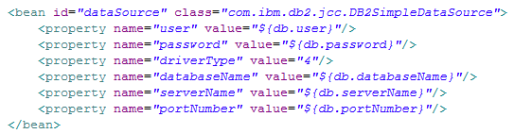
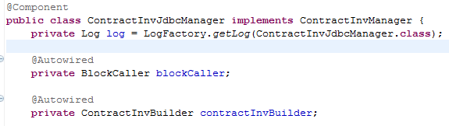
How do beans get created?
Applications have control over what beans are created and used in the container.
This is configuration is done via a context file, typically applicationContext.xml in a web app.
Beans can be declared:
  via XML
  using annotations inside classes.

Slide 20
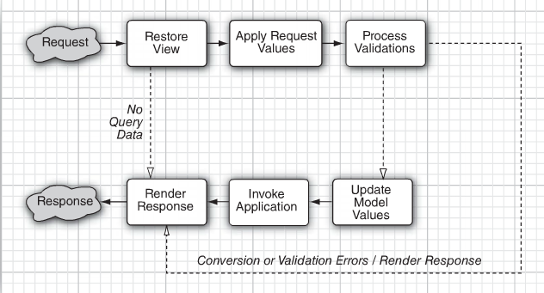

Principal JSF Tie In
Input validations for JSF form fields
Updates backing bean values in Template
Call Template.prerender() for page to display. This should then call Controller.prerender() to load display data for page in Template backing bean.
Render display page using combination of XTHML and values populated in Template backing bean.
Executes action method of button or link clicked on UI (in Template)

Slide 21
Restore View
Input validations for JSF form fields
Updates backing bean values in Template
Call Template.prerender() for page to display. This should then call Controller.prerender() to load display data for page in Template backing bean.
Render display page using combination of XTHML and values populated in Template backing bean.
Executes action method of button or link clicked on UI (in Template)

Slide 22
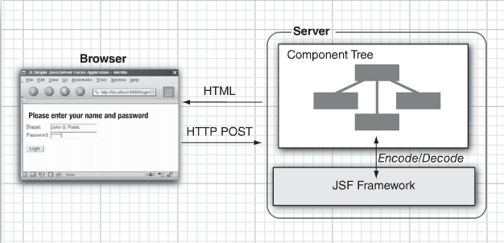
Restore View
If there are no request values, the JSF implementation skips ahead to the Render Response phase (see slide for that phase). This happens when a page is displayed for the first time.
The Restore View phase retrieves the component tree for the requested page if it was displayed previously. For example, you hit the page and then take some action on the page (i.e. click a button).
Rebuilds tree with values from initial page load

Slide 23
Apply Request Values
Input validations for JSF form fields
Updates backing bean values in Template
Call Template.prerender() for page to display. This should then call Controller.prerender() to load display data for page in Template backing bean.
Render display page using combination of XTHML and values populated in Template backing bean.
Executes action method of button or link clicked on UI (in Template)

Slide 24
Apply Request Values
In this phase, the framework iterates over the component objects in the component tree. Each component object checks which request values belong to it and stores them.
Values from xhtml tags, such as <h:selectOneMenu>, get updated from values on web page form to JSF component object
Values entered by user on page get updated in JSF component tree

Slide 25
Process Validations
Input validations for JSF form fields
Updates backing bean values in Template
Call Template.prerender() for page to display. This should then call Controller.prerender() to load display data for page in Template backing bean.
Render display page using combination of XTHML and values populated in Template backing bean.
Executes action method of button or link clicked on UI (in Template)

Slide 26
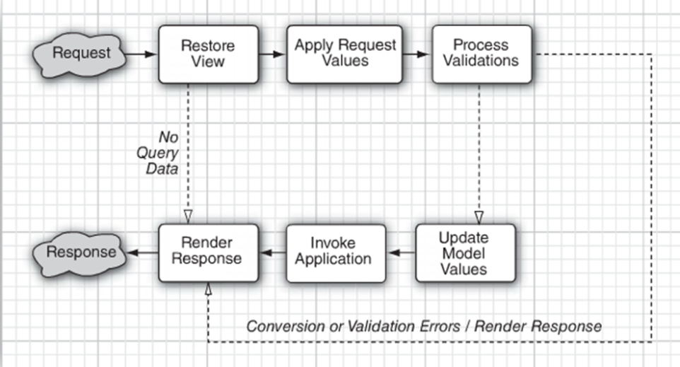
Process Validations
Validators, which we can put along with elements in our XHTML, can perform correctness checks on the local values.
If validation passes, JSF life cycle proceeds normally.
If conversion or validation errors occur, JSF invokes the Render Response phase directly, redisplaying the current page so that the user has another chance to provide correct inputs. Nothing in the Template backing bean gets updated and no action method gets called either.

Slide 27
Update Model Values
Input validations for JSF form fields
Updates backing bean values in Template
Call Template.prerender() for page to display. This should then call Controller.prerender() to load display data for page in Template backing bean.
Render display page using combination of XTHML and values populated in Template backing bean.
Executes action method of button or link clicked on UI (in Template)

Slide 28
Update Model Values
Template backing bean values get updated from JSF component tree.
This means that the Template now contains updated values from what a user changed on a screen and we can do things like update our domain layer with those values (which we will do in the next step).

Slide 29
Invoke Application
Input validations for JSF form fields
Updates backing bean values in Template
Call Template.prerender() for page to display. This should then call Controller.prerender() to load display data for page in Template backing bean.
Render display page using combination of XTHML and values populated in Template backing bean.
Executes action method of button or link clicked on UI (in Template)

Slide 30
Invoke Application
The action method of the button or link clicked that caused the form submission gets executed.
  Actions methods are responsible for handling all update processing. They should call off to the Controller to do all of this type of work. Finally, an action method must return a String with the URL of the page to go to next.
  We define these action methods in our Template backing bean.

Slide 31
Invoke Application
XTHML button logic:
  <h:commandButton action="#{invAttributesTemplate.submitInvestmentAttributesAction}" value="Submit" styleClass="submitbutton" rendered="true"/>
Template action logic
  public String submitInvestmentAttributesAction() {
  // update domains, etc, via the controller
  investmentAttributesController.submitInvestmentAttributesAction(…..)
  return nextPage;
  }
Controller logic
  public String investmentAttributesController.submitInvestmentAttributesAction(…..) {
  // take updated values from screen in backing bean and use managers to update them
  contractInvManager.update(investmentAttributesTemplate.getContractInv());
  }

Slide 32
Render Response
Input validations for JSF form fields
Updates backing bean values in Template
Call Template.prerender() for page to display. This should then call Controller.prerender() to load display data for page in Template backing bean.
Render display page using combination of XTHML and values populated in Template backing bean.
Executes action method of button or link clicked on UI (in Template)

Slide 33
Render Response
Responsible for sending response back to client’s browser for the next page to be displayed to them.
Page to display to user will come from:
  After an action has occurred from the previous page -Value that the action method returned in the invoke application phase
  When hitting the page via a link or direct URL hit – value of URL
    "/invlineup/invlineupedit/invLineup.faces" gets translated to the following 2 files that will get processed next:
      XTHML “WebContent/invlineup/invlineupedit/invLineup.xhtml”
      Template com/principal/ris/contractinvsetup/ui/invlineup/invlineupedit/InvLineupTemplate.java

Slide 34
Render Response
  Template.prerender() will get called. It should then call the corresponding Controller.prerender() to load display data for page in the Template backing bean.
Once prerender() is done with execution, the web page will get rendered using combination of XTHML and values populated in Template backing bean.

Slide 35
JSF Lifecycle
Input validations for JSF form fields
Updates backing bean values in Template
Call Template.prerender() for page to display. This should then call Controller.prerender() to load display data for page in Template backing bean.
Render display page using combination of XTHML and values populated in Template backing bean.
Executes action method of button or link clicked on UI (in Template)

Slide 36
Configuration Files
applicationContext.xml
web.xml
faces-config.xml
pom.xml

Slide 37
Questions?

